Slide 1
Hack The Grid
11/1/2015 Carnegie Mellon University ISR & ENERNOC
Presentation by WBT

Slide 2

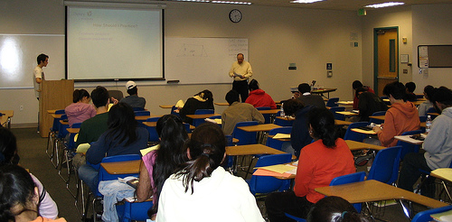

Units
= 20 W
= 480 W
= 373 kW

Slide 3
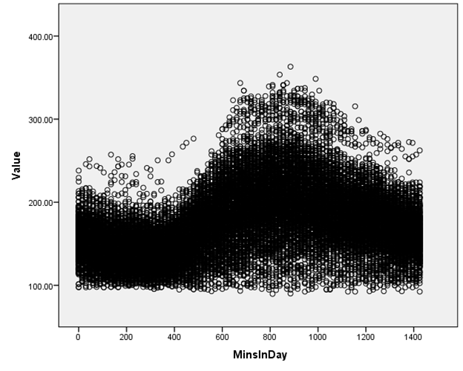

300 S. Craig St. Power Usage
Usage
10am
8pm
Time of day

Slide 4
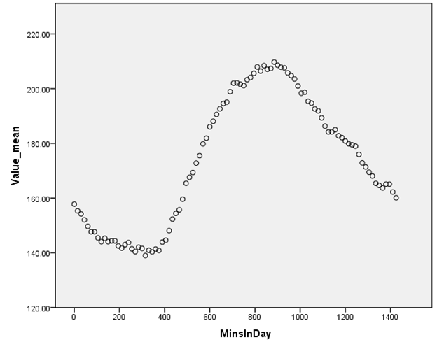
Average Daily Rhythm
Average usage
10am
8pm
Time of day

Slide 5
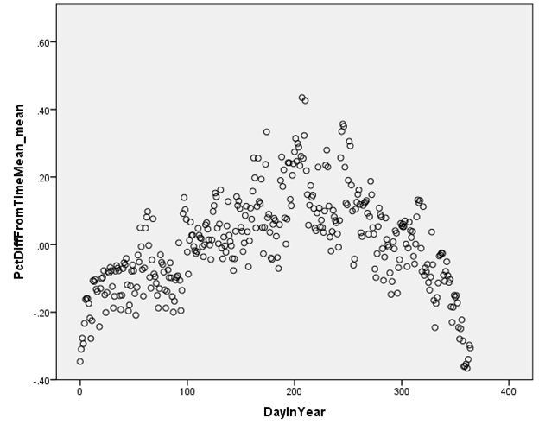
Seasonal Variance
Average % deviation from time-of-day average
Jan.1
Dec. 31
Day in year

Slide 6
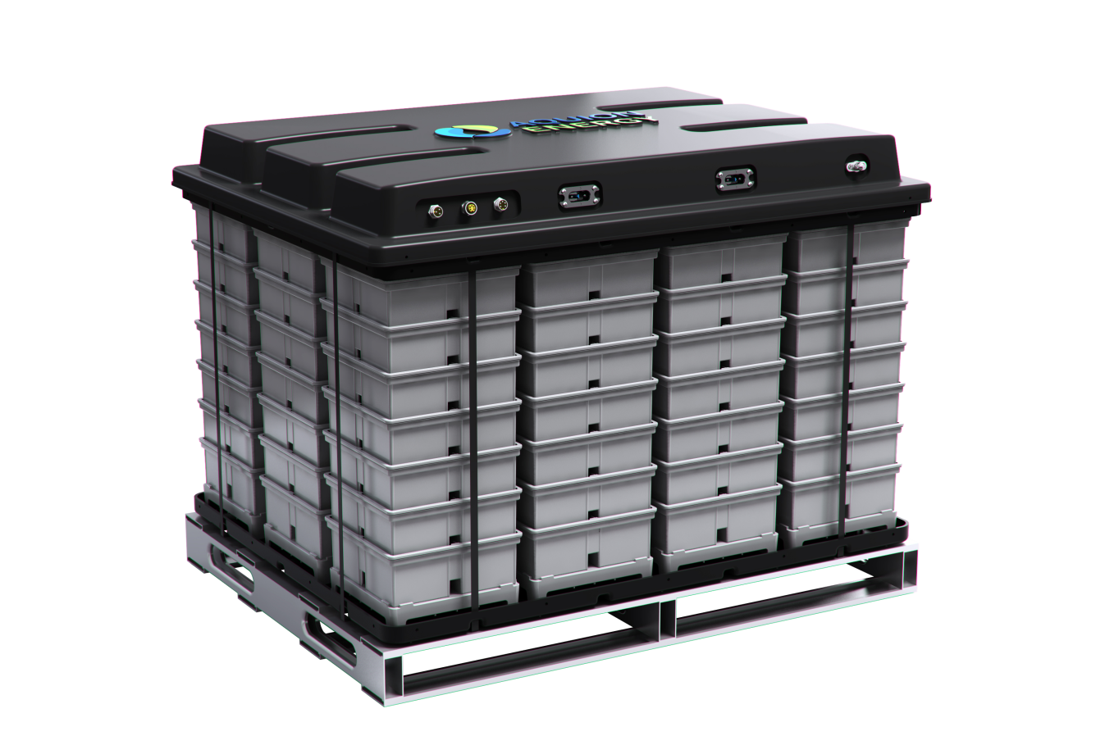

Finding Peak-Shaving Opportunities
Adding local storage or scheduling usage
Optimal: Peak Demand = Average Demand

Slide 7
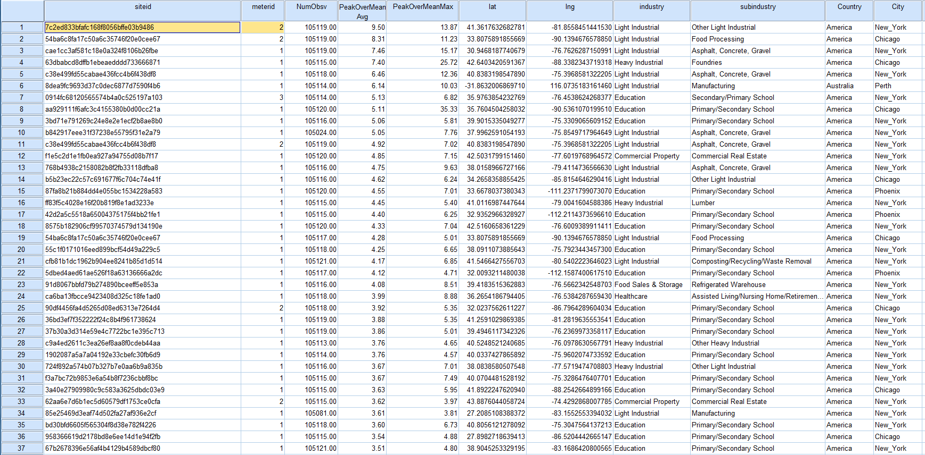
ID strongest opportunities for action

Slide 8
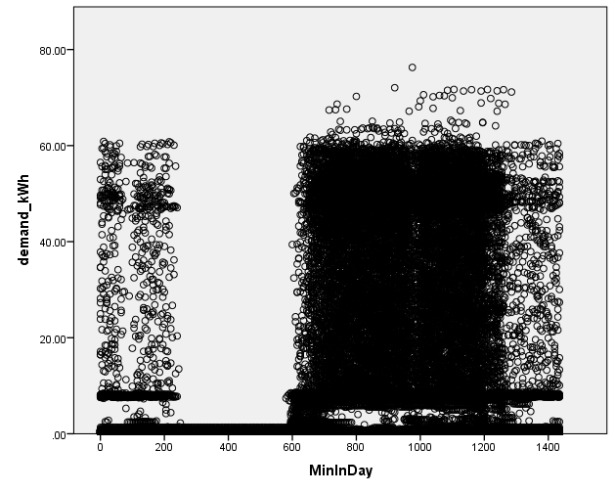
Load-Leveling Opportunity
10am
8pm
Time of day

